Slide 1

TRENDnet Hot Technology Presentation
TRENDnet Technology Conference
May 17 - 18, 2007
Miami, Florida, USA

Slide 2





Agenda
Wireless
Powerline
Web Smart Switches
SNMP
IP Camera

Slide 3



Wireless Agenda
Technology Overview
11G
Super G
Wireless N Draft
Special Applications
Antennas
Product Roadmap

Slide 4
What is Wireless LAN?
Network Data Communication over the Air
Data Superimposed on the Radio Frequency
Signals Penetrate Building Structure
Home or Business
Indoor or Outdoor

Slide 5
Wireless LAN Configurations
Basic Modes
  Peer-to-Peer (Ad-Hoc)
  Client/Server (Infrastructure)
Roaming (from one AP to another)
LAN-to-LAN Bridging
  Point-to-Point
  Point-to-Multipoint
  Client AP (connects to the AP just like a client adapter)
Repeater (repeat the signal)
Integrated Wired/Wireless Internet Router

Slide 6
History of Wireless Speed
2008
802.11n
600Mbps
2003
802.11g
54Mbps
802.11n 1.0 Draft
300Mbps 2.4Ghz
2001
802.11a
54Mbps
MIMO & Smart Antenna
1999
108Mbps & 125Mbps
Turbo Modes Launched
802.11b
11Mbps
802.11g Products
Launched 6 months
Before IEEE Ratification
802.11a faces slow adoption.
802.11b+ doubles speed using
PBCC Technology in TI chipset
Not an official Standard

Slide 7
802.11g
54Mbps

Slide 8

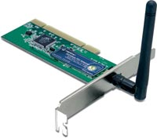
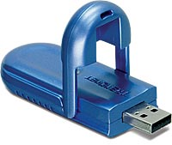
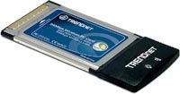
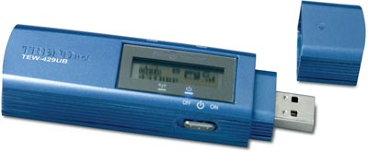
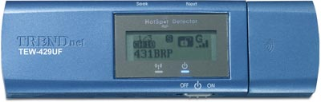
TRENDnet 802.11g Adapters
 | TEW-421PC | TEW-423PI | TEW-424UB | TEW-429UB | TEW-429UF
Product Type | PC Card | PCI Card | USB Adapter | USB Adapter | USB Adapter
802.11b/g | ● | ● | ● | ● | ●
WEP 64/128-bit | ● | ● | ● | ● | ●
WPA/WPA2 | ● | ● | ● | ● | ●
Wi-Fi Locator With LCD Display |  |  |  | ● | ●
512Mb Built-in Flash Memory |  |  |  |  | ●

Slide 9
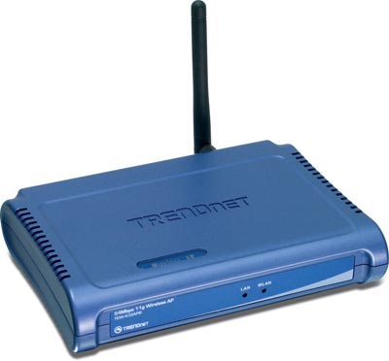

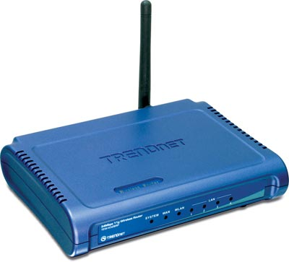
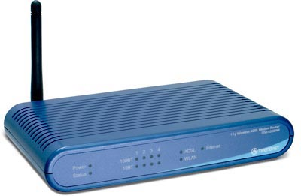

TRENDnet 802.11g AP/ Router
 | TEW-430APB | TEW-434APB | TEW-432BRP | TEW-435BRM
Product Type | Wireless AP | Wireless AP | Wireless Router | Wireless Modem/Router
802.11b/g | ● | ● | ● | ●
WEP 64/128-bit | ● | ● | ● | ●
WPA/WPA2 | ● | ● | ● | ●
Bridge/Repeater Modes | ● | ●
Detachable Antennas | ● | ● | ● | ●
Power over Ethernet |  | ●

Slide 10
Super G
108Mbps

Slide 11


TRENDnet Advanced Wireless
Super G
108Mbps
Meet or Exceed Wired Speeds
Satisfy Multimedia Applications
Voice/Music/Movies
Large File Transfers
Technology | Frequency
Super G | 2.4GHz

Slide 12

Performance Technology
Feature | Characteristics | Benefits
Bursting | More Data per Given Time | Increased Throughput Overhead Reduction
Compression | Real-time Hardware Data Compression | Compressed Frames No Impact on Host Processor
Fast Frame | Frame Aggregation Timing Modifications | Increase Throughput Transmit More Data per Frame
Dynamic Turbo | Similar than Trunking in Switches Dual Wireless Channels Adjust Bandwidth Utilization Accordingly | Maximize Bandwidth using Multiple Channels Environment Aware

Slide 13

Universal Wireless Coverage
Superior Wireless Coverage
Maintain High Data Communication Throughput
Eliminate Indoor Dead Spots
Interoperable With Existing Wireless Standards

Slide 14
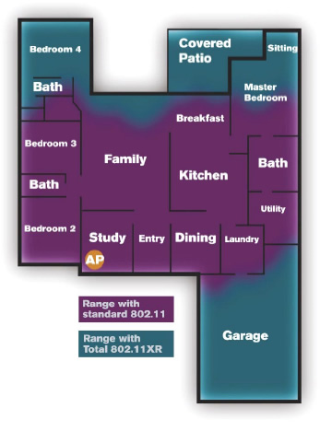
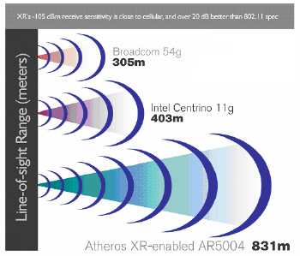
XR Technology
Enhanced Receive Sensitivity
Longer Outdoor Range and No Indoor Dead Spots
Transparent Operation
  No End User Configurations
  Freedom to Enjoy Wireless Connectivity In All Of Your Favorite Locations

Slide 15
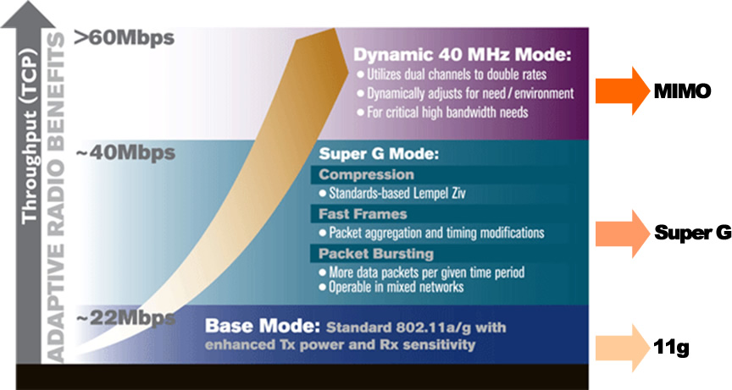
Performance Comparison

Slide 16
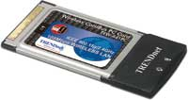
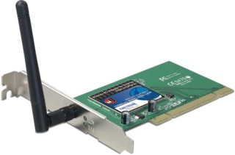
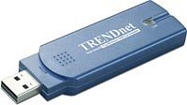

TRENDnet Super G Adapters
 | TEW-441PC | TEW-443PI | TEW-444UB | TEW-445UB
Product Type | PC Card | PCI Card | USB Adapter | USB Adapter
802.11b/g | ● | ● | ● | ●
XR Technology | ● | ● | ● | ●
108Mbps | ● | ● | ● | ●
Detachable Antennas |  | ● |  | ●

Slide 17


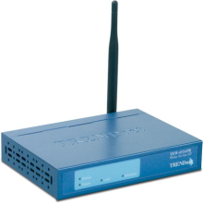
TRENDnet Super G AP/Router
 | TEW-450APB | TEW-452BRP | TEW-453APB
Product Type | Wireless AP | Wireless Router | Wireless AP HotSpot
802.11b/g | ● | ● | ●
XR Technology | ● | ● | ●
108Mbps | ● | ● | ●
Bridge/Repeater Modes | ● |  | ●
Detachable Antennas | ● | ● | ●

Slide 18

N-Draft 1.0 300Mbps

Slide 19
802.11n Timeline
2004
2005
Jan/2006
Nov/2006
IEEE 802.11n Task Group Formed
EWC was Formed to Accelerate Standardization Process
MIMO Added to the Specifications
EWC Draft Spec 1.0 Became Available
Sent to IEEE 802.11n Task Group
IEEE 802.11n Accepted Draft Version 1.0
2009
Anticipated 802.11n Standard

Slide 20
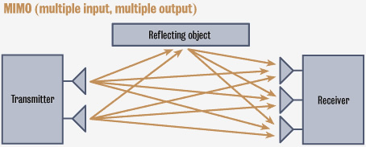
N-Draft / MIMO
Mutiple Input Multiple Output (MIMO)
Multiple Transmitting And Receiving Antennas

Slide 21
802.11n Draft 1.0 Components
Channel Bonding
Packet Processing
MIMO
Compatibility
10X Performance of 11g

Slide 22
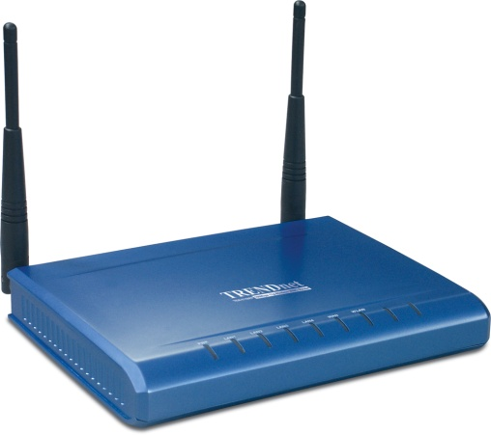
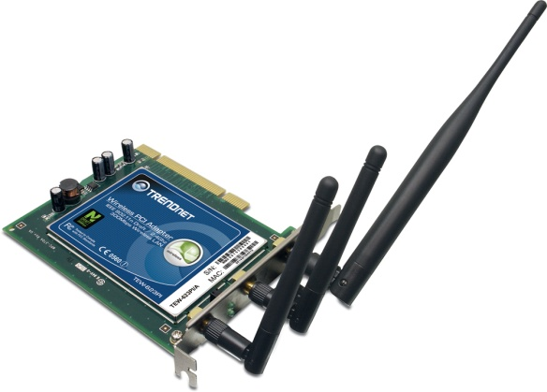
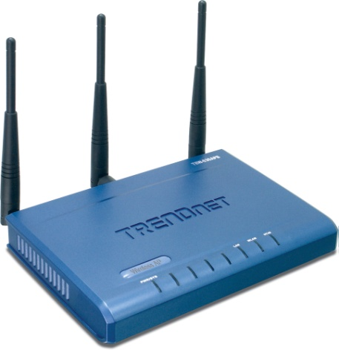
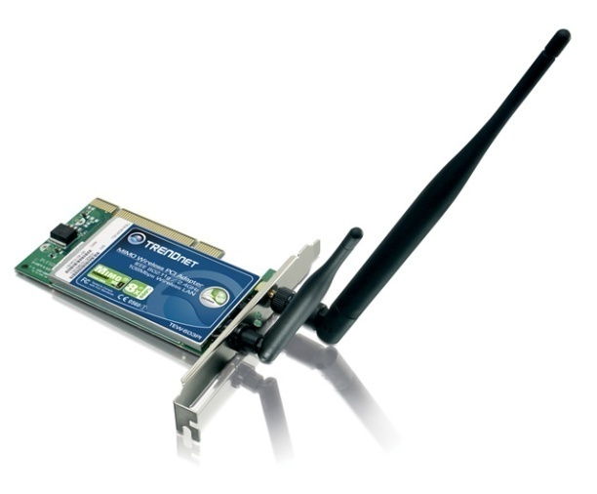
N-Draft/MIMO Antenna
Number of Antennas
  Client Adapter
  Access Point/Router
2 x 2
2 x 3
3 x 3

Slide 23
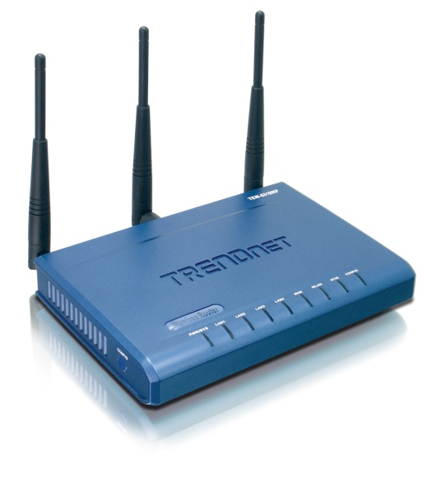
The Power of Three Antennas: Reliable Coverage
50% More Reception Power
50% More Transmission Power
Immediate 1.8dB Gain
Translates into Roughly 50% More Sustained Throughput over a Distance

Slide 24
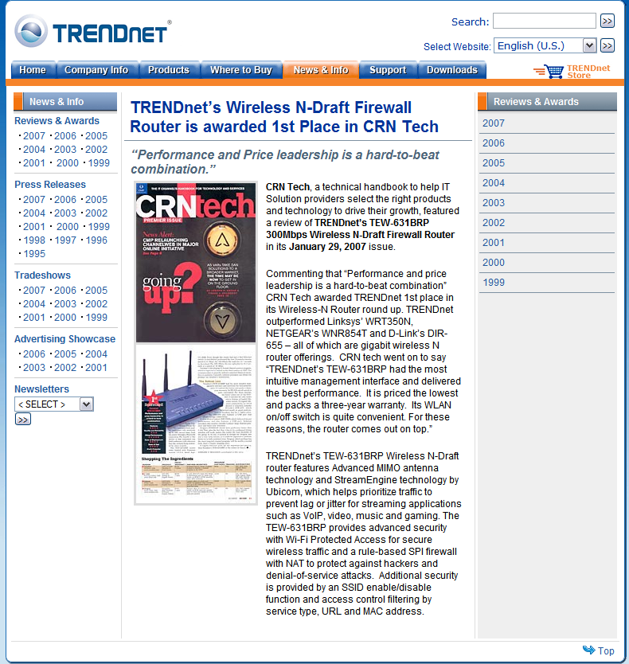
Award Winning Products
TEW-631BRP Received Highest Honor From CRN Tech
January 2007
(Against D-Link, LinkSys, and Netgear)

Slide 25


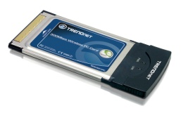
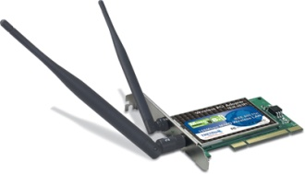
TRENDnet N-Draft Products
 | TEW-631BRP | TEW-630APB | TEW-621PC | TEW-623PI
Device Type | Router | Access Point | PC Card | PCI Adapter
802.11n | ● | ● | ● | ●
WEP 64/128-bit | ● | ● | ● | ●
WPA/WP2 | ● | ● | ● | ●
StreamEngine | ●
WDS Mode |  | ●

Slide 26
TRENDnet Super Wireless Comparison
Technology | Super G | Pre-N/MIMO | N-Draft 1.0 | Future Wireless N
Features | 108Mbps Support Bandwidth Intensive Applications Efficient Data Throughput Backward Compatible with 802.11b/g Standards |  | 300Mbps HD Streaming StreamEngine Exceed Wired Speeds | 600Mbps Dual Bands 11n + 11a/g/b Gigabit Ethernet Performance
Throughput | >40Mbps | >60Mbps | >120Mbps | >200Mbps
Major Differences | XR Technology 2.4GHz | MIMO Smart Antenna Technology 2.4GHz | XSPAN 300 MIMO Smart Antenna Technology | Multiple HD Streaming More Bandwidth

Slide 27
TRENDnet WiFi Overveiw
Wireless Standards (IEEE) | 802.11b | 802.11g | Super G | 802.11n
TRENDnet Products | TEW-221PC TEW-222CF TEW-223PI TEW-224UB TEW-210APB TEW-212APBO | TEW-421PC TEW-423PI TEW-430APB TEW-432BRP (Compatible with 802.11b) | TEW-441PC TEW-443PI TEW-444UB TEW-445UB TEW-450APB TEW-452BRP | TEW-621PC TEW-623PI TEW-624UB TEW-630APB TEW-631BRP
Frequency | 2.4 ~ 2.4835GHz | 2.4 ~ 2.497GHz | 2.412 to 2.484GHz | 2.412 ~ 2.472 GHz
Modulation | DSSS, CCK | CCK, OFDM | CCK, OFDM | OFDM
Speed | Up to 11Mbps | Up to 54Mbps | Up to 108Mbps | Up to 300Mbps
Throughput | 4~5Mbps | 20~25Mbps | 40Mbps | 120Mbps
Channels/Non-Over Lapping | 11/3 | 11/3 | 11/3 | 11/3
WEP Encryption | 64/128-bit | 64/128-bit | 64/128-bit | 64/128
WPA Encryption | N/A | WPA/WPA2 | WPA/WPA2 | WPA/WPA2
Popularity | Widely Used | Widely Used | Growing Popularity | New Technology
Where to Use | Homes, Small Offices, Warehouses Large Campus environments Multiple WLAN network environments and more |  |  | Homes, Small Offices, Labs and Large Conference Rooms

Slide 28



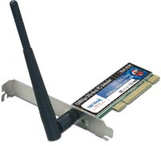





Atheros Platform

Slide 29

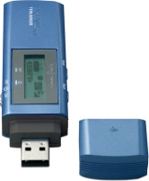
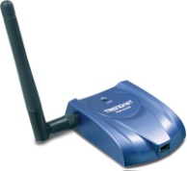

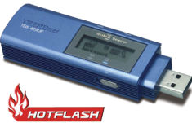
Special Wireless Applications

Slide 30

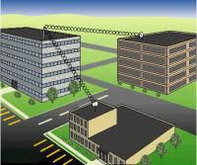
Trendnet Wireless HotSpot
TEW-453APB
  108Mbps Super G
  IEEE 802.11b/g
  Wireless HotSpot Access Point
  Wireless Users Isolation
  Versatile Data Encryption
  Accounting & Billing Support Via Third Party Software

Slide 31
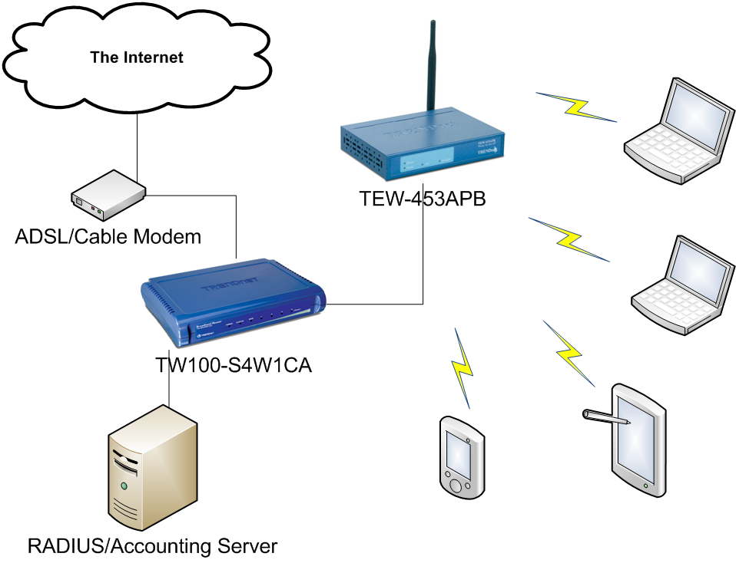
TEW-453APB Wireless HotSpot

Slide 32
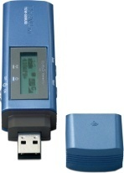



Special Wireless Applications
 | TEW-429UB | TEW-429UF | TEW-509UB | TEW-445UB
USB 2.0 Wireless Adapter | ● | ● | ● | ●
HotSpot Locator | ● | ● | ●
IEEE 802.11 a/g | 802.11g | 802.11g | 802.11a/g | 802.11g
108Mbps Super G/AG |  |  | ● | ●
54Mbps 11g | ● | ● | ● | ●
Detachable Antenna |  |  |  | ●
High Power |  |  |  | ●
512MB Flash Memory |  | ●

Slide 33
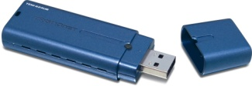
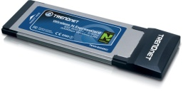
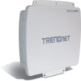


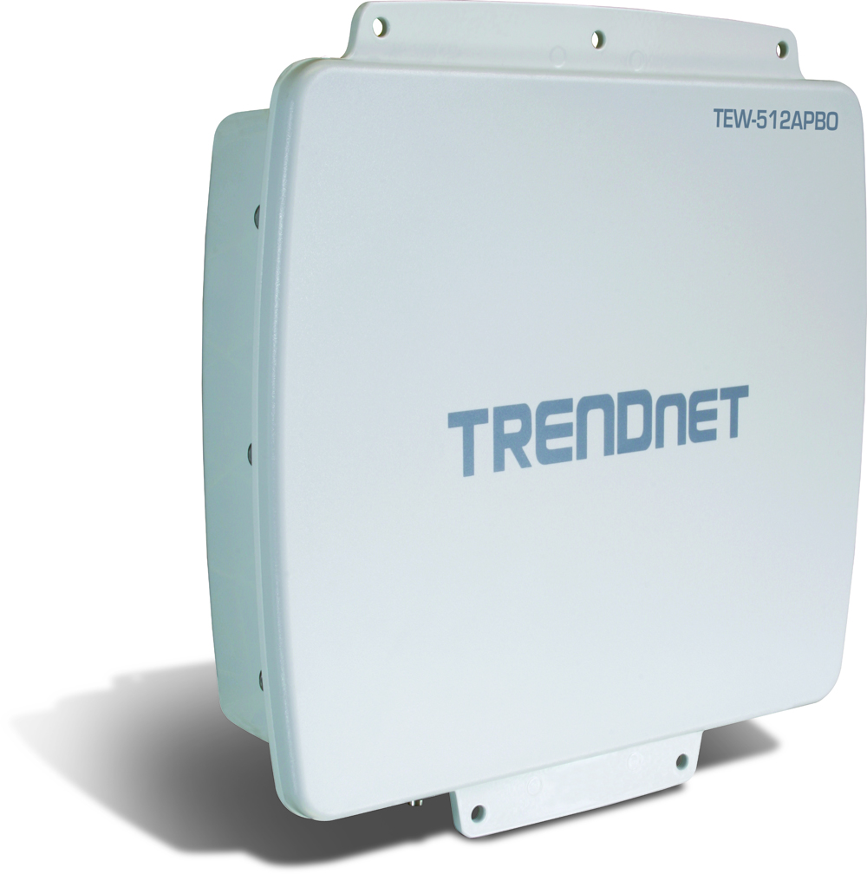
Product Roadmap
Available in 2007
 | TEW-624UB | 300Mbps Wireless 2.0 Adapter
 | TEW-622EC | 300Mbps Wireless
 | TEW-433APBO | 9dBi 54Mbps 802.11g Wireless PoE Outdoor Access Point
 | TEW-633GR | 300Mbps Wireless N Gigabit Gaming Router
 | TUW-101UB | Wireless UWB USB Dongle
 | TUW-400 | 4-Port Wireless UWB USB Hub
 | TEW-512APBO | 108Mbps 802.11a/g Wireless PoE Outdoor Access Point
 | TEW-7113GBR | Wireless 3G Router
 | TEW-912APBO | Wi-Max Outdoor Access Point

Slide 34
Wireless Antennas

Slide 35

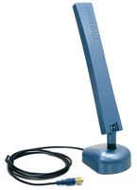

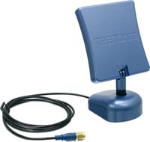
Dual-Band Indoor Antennas
Model Name | TEW-AI750 | TEW-AI75OB | TEW-AI86D | TEW-AI86DB
Gain [dBi] | 802.11a: 7 dBi 802.11g: 5 dBi | 802.11a: 7 dBi 802.11g: 5 dBi | 802.11a: 8 dBi 802.11g: 6 dBi | 802.11a: 8 dBi 802.11g: 6 dBi
Connect | Reverse SMA Female | Reverse SMA Female | Reverse SMA Female | Reverse SMA Female
Pigtail | N/A | 1M | N/A | 1M
Antenna Type | Omni-Directional | Omni-Directional | Directional | Directional
Remark | Direct Connection | Magnetic Base With Pigtail Extension | Direct Connection | Magnetic Base With Pigtail Extension

Slide 36
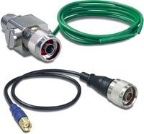
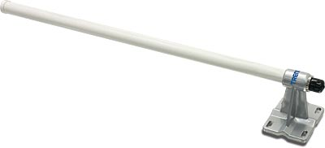
Outdoor Omni-Directional Antennas
Antenna | Protection Kit | Antenna Cable | Effective Range | Wireless Mode
TEW-AO08O | TEW-ASAK | TEW-L406 [LMR400 6M] | 800M [.5 Miles] | 11b/g 2.4~2.5GHz
 |  | TEW-L412 [LMR400 12M] | 400M [.25 Miles] | 11b/g 2.4~2.5GHz
TEW-AO10O | TEW-ASAK | TEW-L406 [LMR400 6M] | 1200M [.75 Miles] | 11b/g 2.4~2.5GHz
 |  | TEW-L412 [LMR400 12M] | 600M [.37 Miles] | 11b/g 2.4~2.5GHz

Slide 37
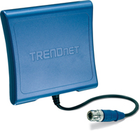
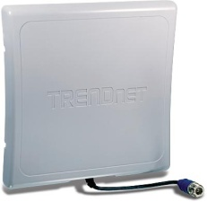

Outdoor Directional Antennas
Antenna | Protection Kit | Antenna Cable | Effective Range | Wireless Mode
TEW-AO09D | TEW-ASAK | TEW-L406 [LMR400 6M] | 800M [.5 Miles] | 11b/g 2.4~2.5GHz
 |  | TEW-L412 [LMR400 12M] | 400M [.25 Miles] | 11b/g 2.4~2.5GHz
TEW-AO14D | TEW-ASAK | TEW-L406 [LMR400 6M] | 1200M [.75 Miles] | 11b/g 2.4~2.5GHz
 |  | TEW-L412 [LMR400 12M] | 800M [.37 Miles] | 11b/g 2.4~2.5GHz
TEW-AO19D | TEW-SAK | TEW-L406 [LMR400 6M] | 4000M [.75 Miles] | 11b/g 2.4~2.5GHz
 |  | TEW-L412 [LMR400 12M] | 2000M [.37 Miles] | 11b/g 2.4~2.5GHz

Slide 38
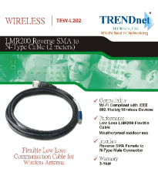

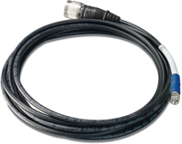

Antenna Cables
Indoor LMR200 Cables
Model name | TEW-L202 | TEW-L208
Connector interface | N-Type Male to Reverse SMA female | N-Type Male to Reverse SMA female
Length (meter) | 2 | 8
Total cable loss (dB) | 1.5 | 4.8
Actual antenna gain after connecting this cable (if antenna is 8dBi) | 8 – 1.5 = 6.5 | 8 – 4.8 = 3.2

Slide 39
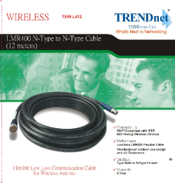

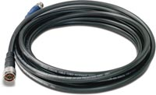
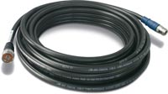
Antenna Cables
Outdoor Low Loss LMR400 Cables
Model name | TEW-L406 | TEW-L412
Connector interface | N-Type Male to N-Type Female | N-Type Male to N-Type Female
Length (meter) | 6 | 12
Total cable loss (dB) | 1.72 | 3
Actual antenna gain after connecting this cable (if antenna is 14dBi) | 14 – 1.72 = 12.28 | 14-3=11

Slide 40

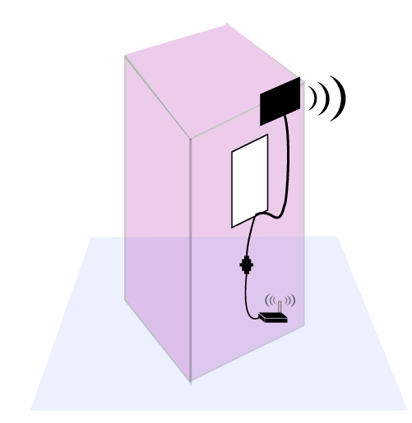
Outdoor Surge Arrestor Kit
Outdoor Surge Arrestor Kit contains
surge arrestor + connector cable
Model Number | TEW-ASAK
Converter | N-Type Male to Reverse SMA female
Length | 30cm
Surge protector | N-Type Male to N-Type Female
TEW-ASAK
Surge Arrestor
TEW-ASAK
Connector cable

Slide 41


Powerline
TRENDnet Powerline Networking Technology

Slide 42
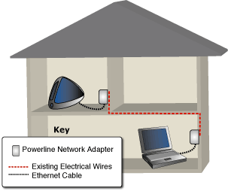
What is Powerline?
Network with Power Outlets in Home/Office
Cost Effective
  Network Cable Not an Issue
Great for certain types of construction and for areas with a lot of wireless installations

Slide 43
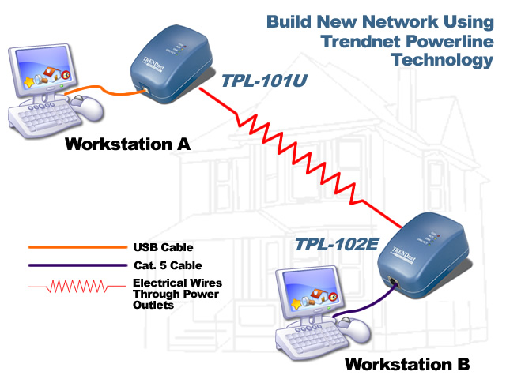

Powerline Solutions
TPL-202E

Slide 44
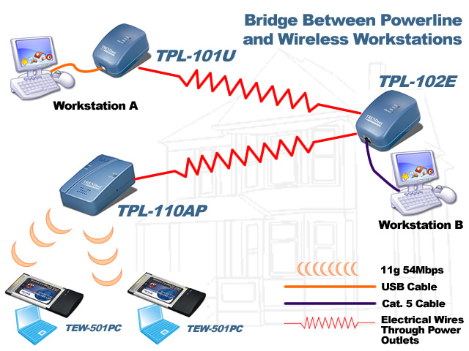
Powerline Solutions
TPL-202E

Slide 45

Powerline Solutions
TPL-202E

Slide 46

Security
Password Protected
Build-in 56-bit Data Encryption Security (DES)
Centralized Password Management
Wireless: WEP, WPA, WPA2

Slide 47




TRENDnet Products
Model # |  | Description
TPL-310AP |  | 200Mbps Powerline Wireless Access Point
TPL-302E |  | 200Mbps Powerline Ethernet Bridge
TPL-210AP |  | 85Mbps Powerline Wireless (g) Access Point
TPL-202E |  | 85Mbps Powerline Fast Ethernet Bridge
TPL-101U |  | USB 2.0 Powerline Adapter
TPL-110AP |  | 14Mbps Powerline 802.11g Wireless Access Point
TPL-111BR |  | 14Mbps Powerline 802.11g Wireless Router

Slide 48
Compatibility
Powerline Standards
14Mbps
HomePlug Powerline 1.0.1
85Mbps
HomePlug Powerline 1.0 Turbo
200Mbps
HomePlug AV

Slide 49



Compatibility
200Mbps
85Mbps
200Mbps
14Mbps

Slide 50
Compatibility
85Mbps
200Mbps
No
Yes
14Mbps
No
No
200Mbps
Yes
Compatible in a Mixed Environment
No
Not Compatible in a Mixed Environment

Slide 51

Web-Smart
Ethernet Switch

Slide 52
What’s Web Smart Switch
Web Smart Switches are Ethernet Switches with light management functions
Easy to configure the Smart Switches
Users can learn how to operate the switch in 10 minutes
Web access through standard web browser
Centrally monitor multiple switches in one screen

Slide 53
What’s Web Smart Switch (cont.)
Web Smart Switches have powerful L2 functions but with very low cost
  Opens almost all the powerful functions of the L2 switch chipset.
  Low cost CPU design and small memory footprint to achieve cost effective solutions

Slide 54

Management
Secured Login

Slide 55

Management
Display System Information

Slide 56

Management
Display System Status

Slide 57

Management
Manage Port Settings

Slide 58

Auto-Discovery
Find All Web-Smart
Switches on the LAN
Broadcast Domain

Slide 59


Central Monitoring
Users can monitor all Web-
Smart Switches on the
network and view traps and
log records through the Auto-
Discovery program

Slide 60






Web Smart Switches
 | Model | 10/100Mbps Ports | 1000Mbps Ports | Mini-GBIC Slots | Power over Ethernet
 | TEG-224WS+ | 24 | 2 | 2 (Shared)
 | TEG-2248WS | 48 | 2 | 2 (Shared)
 | TEG-160WS | 16
 | TEG-240WS | 24
 | TEG-448WS |  | 48 | 4 (Shared)
 | TPE-224WS | 24 | 4 | 2 (Shared) | 24

Slide 61

SNMP

Slide 62

SNMP
Simple Network Manageability Protocol

Slide 63


SNMP Technology Overview
Common SNMP Applications
Monitor Network Traffic
    Per Port
    Per Switch
Network Utilization
Protocol Utilization
Maintain Network Health
Security

Slide 64


SNMP Technology Overview
SNMP Manager
Any Workstation with SNMP Compliant Software
Any Workstation with an Internet Browser (Internet Explorer)
SNMP Agent (or Managed Device)
Devices Compliant with SNMP
Devices with Built-in Management Information Base (MIB)

Slide 65










SNMP Technology Overview
SNMP Manager
HP OpenView
Network Instruments Observer
SNMP Agent (Managed Device)
TEG-S081Fi
TEG-S2400i
TFC-1600MM
TE100-S810i
TEG-S3000i
TE100-S800i
TEG-S2600i
TEW-453APB

Slide 66








SNMP Products
 | Model | 10/100Mbps Ports | 100Mbps Ports | 1000Mbps Ports | Module Ports
 | TE100-S800i | 8
 | TE100-S810Fi | 8 | 1 (MM Fiber SC)
 | TEG-S081Fi |  | 8 (MM Fiber SC) |  | 1 (GBIC)
 | TEG-S2400i | 24 |  |  | 1
 | TEG-S2600i | 24 |  | 4 | 1
 | TEG-S3000i |  |  |  | 4
 | TFC-1600MM | Designed for TFC-1600 Chassis
 | TEW-453APB | 108Mbps Super G Wireless HotSpot

Slide 67


TRENDnet
Internet Camera Servers

Slide 68
Technology Overview
Transmit High Quality Video Over Intranet/Internet
Manage Through Web Browser
Standalone System with Built-In CPU
Support Alarm-Based Events
Live Video Anywhere In The World
Record Video and Audio Directly To Hard Drive

Slide 69

Where are Network Cameras Used?

Slide 70

Where are Network Cameras Used?

Slide 71

Network Camera Overview

Slide 72

Remote Monitoring Applications

Slide 73



FTP Uploading Capabilties
Camera Network
Miami, FL
Internet
FTP Server
New York, NY
Remote Office
Los Angeles, CA

Slide 74






Camera Management
IPView Pro

Slide 75



Camera Management

Slide 76


Camera Management
Full Screen View

Slide 77








Step 1: Open IPView Pro
Step 6: Save Configuration
Step 7: View Camera
Step 3: Search For Cameras
Step 2: Click Configuration Button
Step 8: Select Recording Mode
Step 4: Select A Camera
Step 5: Add Camera

Slide 78

Motion-Detected Recording

Slide 79



Wired Network Cameras

Slide 80

Wireless Network Cameras

Slide 81

Outdoor Camera Enclosures

Slide 82

Product Roadmap
TV-IP100/100W New Housing

Slide 83

Product Roadmap
TV-IP400/400W New Housing

Slide 84


Product Roadmap
Available in 3 - 6 Months
 | TV-IP212 | TV-IP212W | TV-IP222 | TV-IP222W | TV-IP412 | TV-IP412W
Powerful ARM 9 CPU | ● | ● | ● | ● | ● | ●
M-JPEG and MPEG4 | ● | ● | ● | ● | ● | ●
2-Way Audio | ● | ● | ● | ● | ● | ●
Day and Night |  |  | ● | ●
Pan-and-Tilt |  |  |  |  | ● | ●
Secured HTTP (HTTPS) | ● | ● | ● | ● | ● | ●
Record to USB Flash Drive | ● | ● | ● | ● | ● | ●
Schedule Motion Record | ● | ● | ● | ● | ● | ●

Slide 85
Thank You
Questions?

